Slide 1
°

Slide 2
in a nutshell
www.carto.com
Presented by Erin Miller & Heye Horlings
GEO 244 • Spring 2017
Professor Christina Friedle

Slide 3
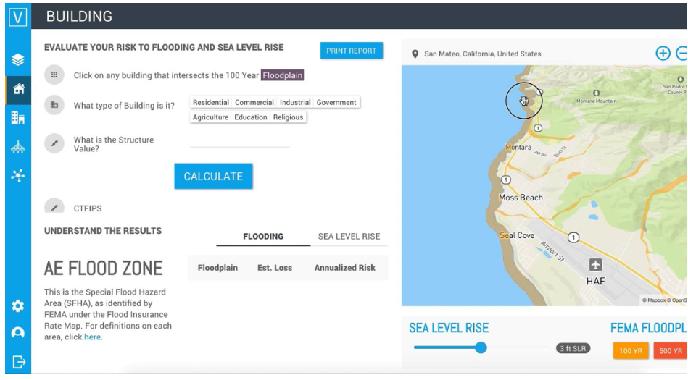
What is ?
Spatial Mapping
Data Visualization
SaaS Cloud based
Use Carto free platform or DIY Open Source
“Freemium” Tiered
Owned by Vizzuality in Spain, with UK and US offices.
Notes:
Two Clicks – Slide 1 and Graphic Float in
Spatial Mapping and Data visualization TOOL
Cloud base, Software as a Service
You can use their company platform and build from it (with some limits) or
Write code to your liking because it is OPEN SOURCE!!
Just like most SAAS, Freemium meaning some features are free, but pay based on a service tier.
Offices in Spain and UK and US

Slide 4
Technology Categories
Library
Application Program Interface (API)
Data/Tile Creation
Notes:
We discovered CARTO utilizes
Library Data/Tile Creation and Application Program Interface (API)
to accommodate every need.
TITLE: BASE MAPS GOOGLE or LEAFLIT.

Slide 5
Overview of Tools Offered
Carto Builder
Tool is basic
Connect to multiple sources of data and links
WGS 84 projection or one of your choice
Drag and Drop
Provides common functions and analytics such as those found in Google Maps, ESRI, Leaflet
Notes:
One example of many.
Carto Builder tool-Basic web based allows you to pull data form multiple sources and link to other types of drives and applications. (live) platform to utilize provides basic functions and analytics similar Google, ESRI, Leaflet etc.
WGS 84 projection
Carto engine and enterprise are more advanced products with more tools available

Slide 6
Programing Languages
HTML
CSS (own version is CARTOCSS)
JAVASCRIPT
Notes:
#5The usual suspects of web programing languages
HTML, CSS, JAVASCRIPT

Slide 7
How Much Documentation?
CARTO .js SQL API Maps API Import API Data Service API | Data Observatory API Carto CSS Torque.JS Mobile SDK Guide | Carto Enterprise Carto Editor FAQ Tips and Tricks CARTO Editor
Notes:
3. How much documentation?
It’s open source, so you can expect a lot to build a dynamic geospatial datasets and scalable maps for your own custom application
CARTO .js
SQL API
Maps API
Import API
Data Service API
Data Observatory API
Carto CSS
Torque.JS
Mobile SDK
Guides
Carto Enterprise
Carto Editor FAQ
Tips and Tricks
CACRTO Editor

Slide 8
Functionality Included…
Export/Import | Basemap styling
Map vs. Imagery | Vector overlays
Tile rendering | Static and Animated Heatmaps
Choropleth | Animation bivariate/multivariate
Symbolize | Pan and zoom
Filter search | Mobile support
Location aware | Drag and drop
Notes:
4. What type of Functionality is included (refer to U of Wisconsin study)
“Anyone Can Use Carto”
Drag and drop shapefile, geojSON or CSV right into the page
Sync data feature-real time data National Weather Service,
Export/Import
Map vs. Imagery
Basemap styling
Tile rendering
Vector overlays
Static and Animated Heatmaps
Choropleth
Animation bivariate/multivariate
Symbolize
Pan and zoom
Filter search
Mobile support
Location aware
Drag and drop

Slide 9
Demo Time! www.carto.com
Notes:
Demonstration of interactive map using this technology
We go live.

Slide 10
Can you Mash-up Carto?
Notes:
7: What “mash-up”
Jquiry leaflet, google, and a few other programs
Carto builders already programed to be other technology

Slide 11
Questions?
Notes:
Anything else to add?
Ton of examples
Show our example.
Questions?

Slide 12
Thank you.

